Slide 1
Image-Based Recipe Suggestion Engine
Amandeep Singh Chabada

Slide 2
Motivation
Internet Revolution: Wealth of recipes everywhere
A Question Unanswered: “What can I make with these ingredients?”
Existing Solutions: Current tools lack intuitiveness
Our Vision: Immersive, image-based search tool.
The Project: Input an image of ingredients and get a recipe suggestion!

Slide 3
Related Work
Rokon and Morol [2021]:
Food recipe recommendation based on ingredients detection using deep learning
Used CNNLeCun for individual ingredient recognition.
Limitation: Single ingredients only.
Notes:
Rokon and Morol [2021]: This study leveraged CNNLeCun et al. [1989] for individual ingredient recognition, creating recommendations based on inputs.
Limitation - only recognized images of single ingredients, not combined pictures.

Slide 4
Related Work
Salvador et al. [2017]:
Learning cross-modal embeddings for cooking recipes and food images.
Employed deep neural networks, using Recipe1M dataset to associate food images with recipes.
Limitation: Focuses on whole dish images, not individual ingredients.
Notes:
Salvador et al. [2017]: Introduced the Recipe1M dataset, using deep neural networks to link food images with their respective recipes. Their approach involved a dual-encoder model and attention mechanisms for ingredient recognition.

Slide 5
Problem Statement
“Making searching for recipes seamless and intuitive by using a snap!”
Challenges:
Data collection
Image recognition algorithm
NLP and information retrieval models
User interface

Slide 6

Solution Architecture
Input Image
Google
Cloud Vision
API
User
Search Query
Database
Processed Entries
Ranking Algorithm
Results

Slide 7
GoogleCloud Vision API Overview
What is Google Cloud Vision API?
Key Features:
Image Labeling
Optical Character Recognition (OCR)
Object Detection
Our Application:
Image recognition
Benefits:
Efficient
Accurate
Notes:
What is Google Cloud Vision API?
An AI service from Google that provides pre-trained machine learning models to analyze images.
Key Features:
Image Labeling: Recognizes entities within an image across a broad group of categories.
Optical Character Recognition (OCR): Extracts text from images in over 50 languages.
Object Detection: Detects multiple objects in an image, providing information about the object and where it was found.
Face Detection: Detects multiple faces within an image, along with associated facial attributes.
Our Application:
Image recognition: We utilized Google Cloud Vision API to recognize the ingredients from user's image input.
Integration: Seamlessly integrated with our system to facilitate our image-based recipe search.
Benefits:
Efficient: Reduced development time with its pre-trained models.
Accurate: Delivers high-precision image recognition.

Slide 8

Retrieval Process
Preprocessing
Ranking Algorithm
Tokenization
Word2Vec
Database
Stop-word Removal
Cosine Similarity
Lemmatization
Processed Search Query

Slide 9
Algorithm Overview – Pre-Processing
Tokenization
Input: "The quick brown fox jumps over the lazy dog."
Output: ["The", "quick", "brown", "fox", "jumps", "over", "the", "lazy", "dog."]
Stop-word Removal
Input: "The quick brown fox jumps over the lazy dog."
Output: ["quick", "brown", "fox", "jumps", "lazy", "dog."]
Lemmatization
Input: "The quick brown fox jumps over the lazy dog."
Output: ["The", "quick", "brown", "fox", "jump", "over", "the", "lazy", "dog."]
Notes:
Tokenization: Breaks down the input text into individual tokens or words.
Stop-word Removal: Eliminates common words (e.g., "the," "is," "and") that carry little semantic meaning.
Lemmatization: Reduces words to their base or root form (e.g., "running" to "run") for better semantic analysis.

Slide 10
Algorithm Overview – Ranking Algorithm
Word2Vec
Input: Word "fox"
Output: Numerical vector representation of "fox" (e.g., [0.2, -0.5, 0.8, ...])
Cosine Similarity.
Input: Numerical vectors representing "cat" and "dog".
Output: Cosine similarity score between the vectors, indicating their similarity (e.g., 0.92).
Notes:
Ranking Algorithm
Word2Vec: Maps words to numerical vectors, capturing semantic relationships.
Cosine Similarity: Measures the similarity between two vectors by calculating the cosine of the angle between them.

Slide 11

Recipe Database
Source: Kaggle
Recipes: 13501
Sample Data:
Id | Title | Ingredients | Instructions
1 | Persimmon Cranberry Sauce | [1/2 cup cranberries,2 cup water,…] | Step1… Step2 …
2 | Mexican Chopped Salad | [1 cup lettuce, 1 1/2 cup black beans, ..] | Step1… Step2 …

Slide 12

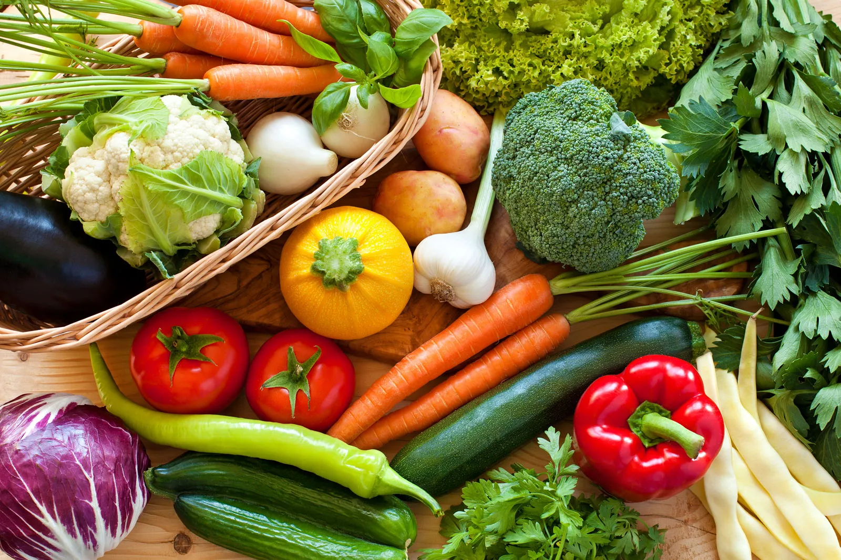
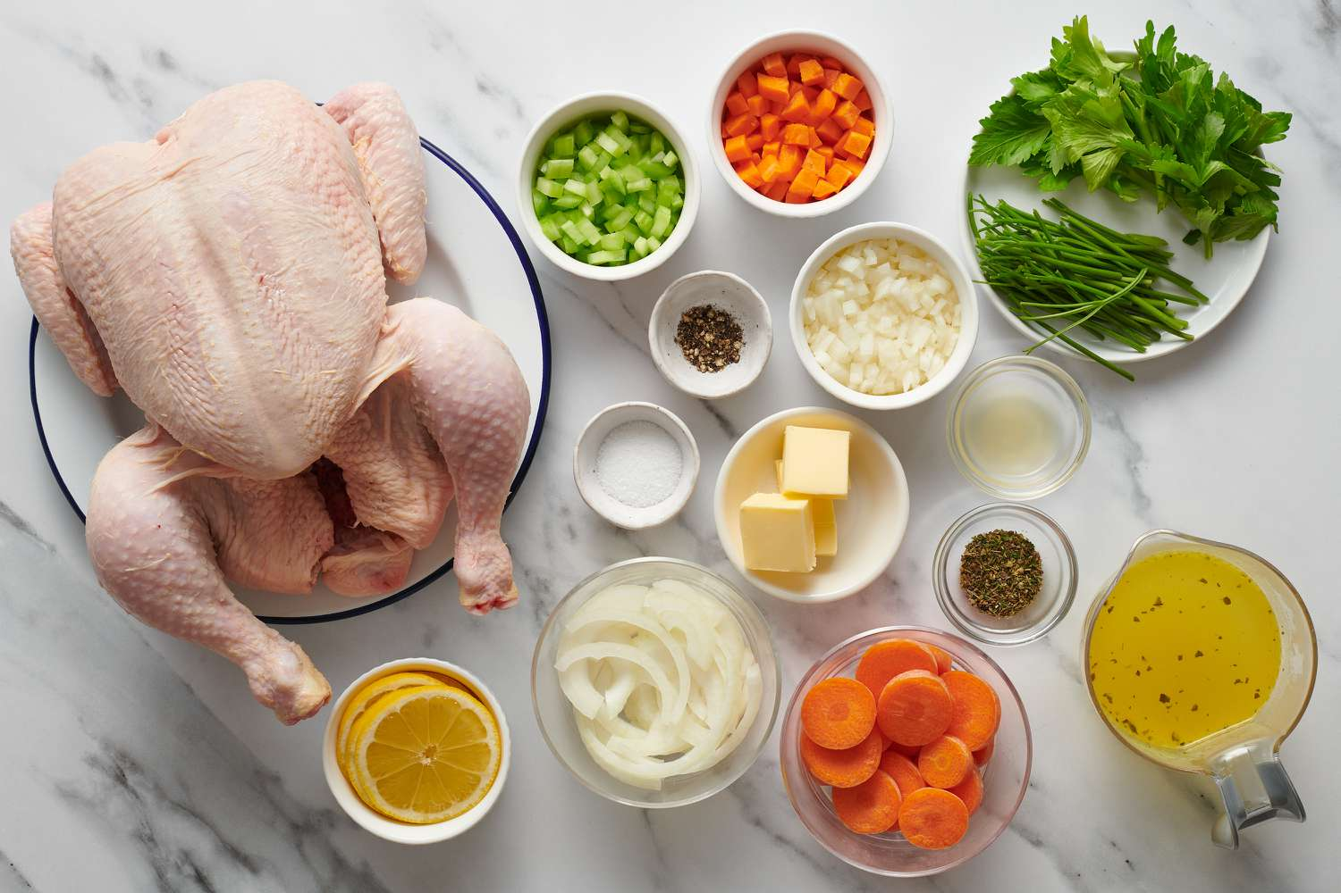
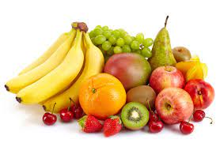
Experiments– Input Images
[Carrots, Bell pepper, Garlic, Broccoli, …]
[Chicken, Carrots, Butter , Celery, …]
[Banana, Orange, Apple , Grapes, …]

Slide 13

Evaluation Metrics
Precision:
High precision = Less false positives
Precision = True Positives / (True Positives + False Positives)
Recall (Sensitivity):
High recall = Less false negatives
Recall = True Positives / (True Positives + False Negatives)
F1 Score:
High F1 Score = Balanced precision and recall
F1 Score = 2*(Precision * Recall) / (Precision + Recall)
Notes:
Precision: Measures the accuracy of correctly predicted positive observations out of total predicted positives.
Recall (Sensitivity): Reflects the ability to find all relevant instances in a dataset.
F1 Score: The harmonic mean of precision and recall, providing a balance between the two.

Slide 14
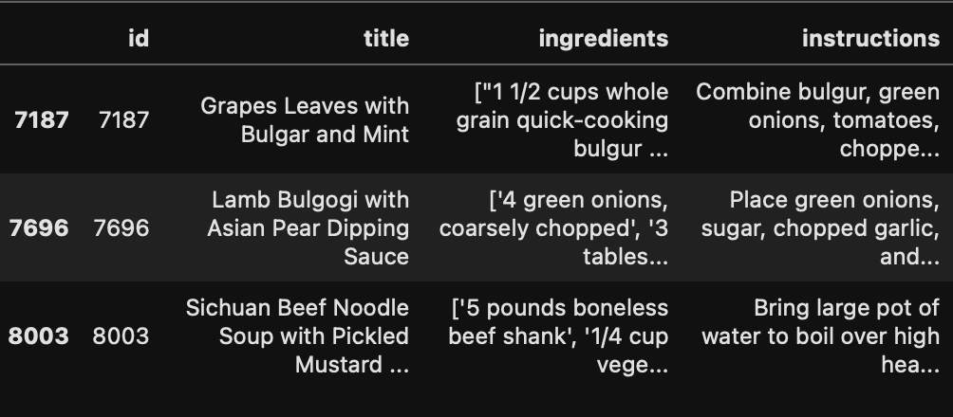
Experiments– Outputs
Precision | Recall | F1 Score
0.65 | 0.72 | 0.68

Slide 15
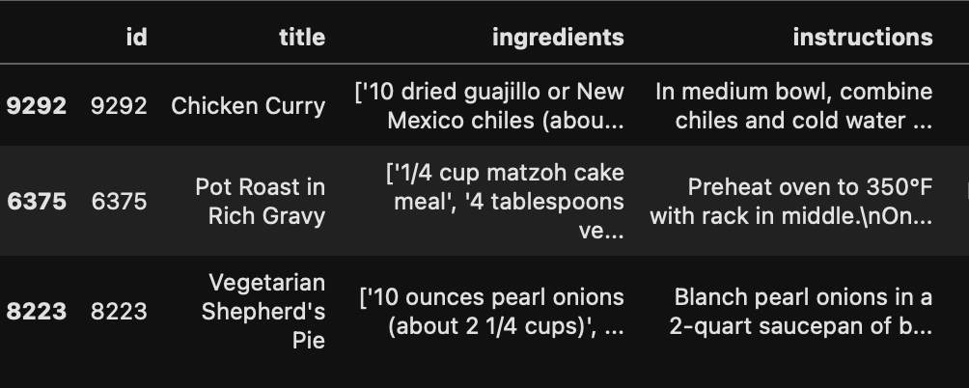
Experiments– Outputs
Precision | Recall | F1 Score
0.76 | 0.62 | 0.68

Slide 16
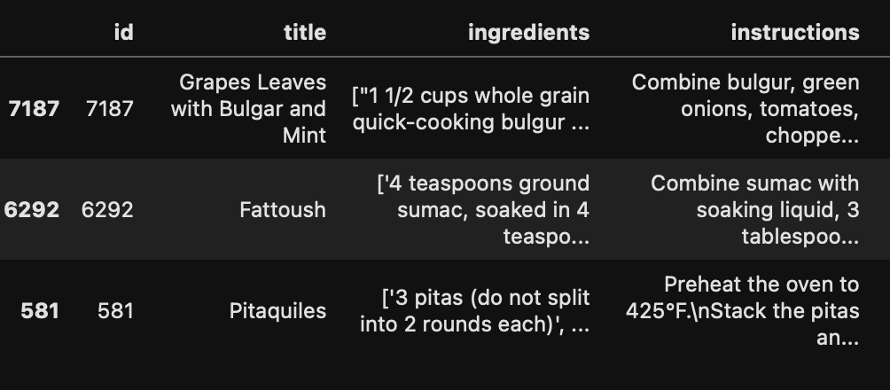
Experiments– Outputs
Precision | Recall | F1 Score
0.8 | 0.7 | 0.74

Slide 17

Summary & Conclusion
Our Vision: Making the recipe discovery process as intuitive as taking a snap, eliminating the need for text-based searches.
Challenges: We tackled data collection, image recognition, NLP models, and user interface design to bring our vision to life.
Solution Architecture: Utilized tokenization, stop-word removal, and a ranking algorithm leveraging Word2Vec and Cosine Similarity.
Evaluation Metrics: We used Precision, Recall, and F1 Score to evaluate our model's performance.
Achieved balanced results leaning towards precision.

Slide 18
Future Work
Data Expansion: Continue growing our recipe database to encompass more diverse cuisines and dietary preferences.
Algorithm Improvement: Refine our image recognition and information retrieval models to boost accuracy and efficiency.
Develop an intuitive User Interface : Create a webapp UI to make it more engaging and easier to use.

Slide 19
THANK YOU

